Slide 1
Predicting Song Popularity
A Hobbit’s Tale

Slide 2
Introduction
In this step of our project we started to look for correlations between popular songs and their audio data so we would be able to start to define what makes a given song “popular”
Depending on what attributes a newly released song possesses we could then use our findings to see if we can predict whether or not that song will be popular

Slide 3
The Data
Retrieving
Spotify API had built in categories for describing audio in each track which it got from a site called echo nest. We chose to use these categories to help determine what makes a given song popular.
Billboard's hot 100 was where we ended up getting our tracks to look up via Spotify’s API because of how much data Billboard has going back as far as 1960
Processing
Overall the Spotify API gave the data back faily cleanly
Some songs had no audio description data thus they had to be removed
Metadata we didn't need was also attached to each track, which had to be cut

Slide 4
The Data
Description of audio features we used…
Danceability - how suitable a track is for dancing based on a combination of musical elements as well as overall regularity.
Energy - how intense or active a track is. Death metal is high energy while a Claire de Lune is low energy.
Loudness - the overall loudness of a track measured in decibels, averaged across the track
Tempo the measure of in beats per minute in a track
Valence - measure describing the musical positiveness; high valence sounds positive while low valence sounds negative

Slide 5
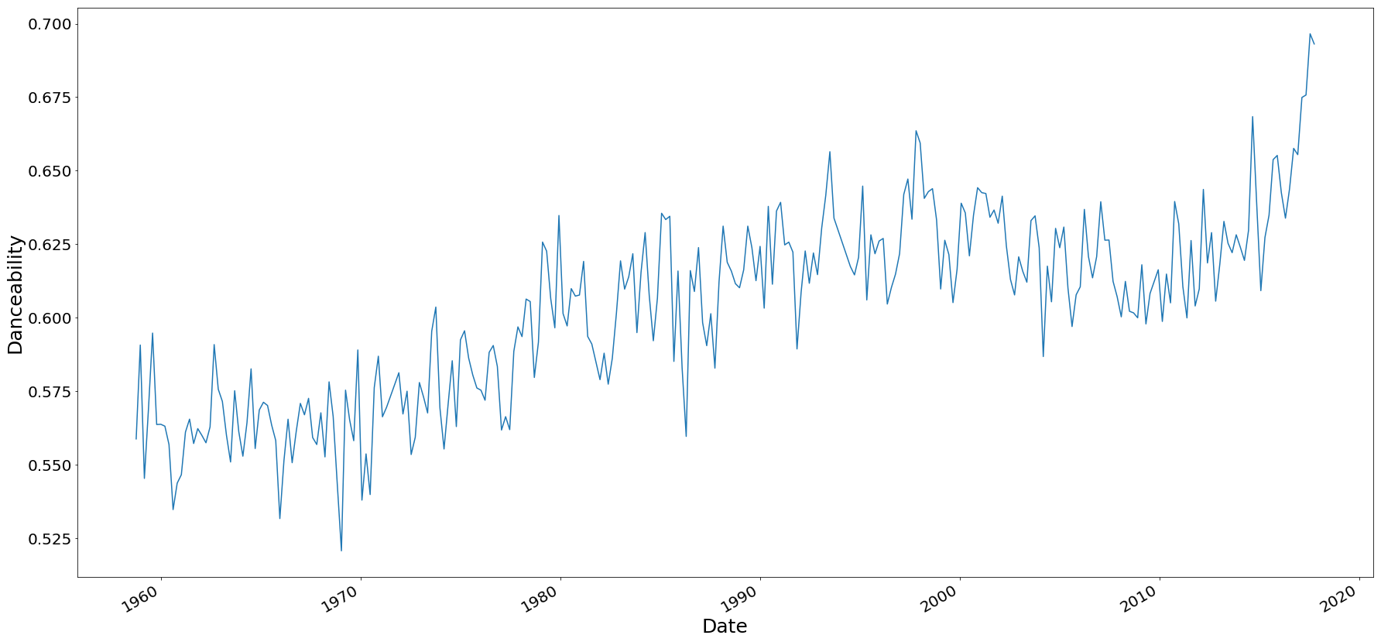
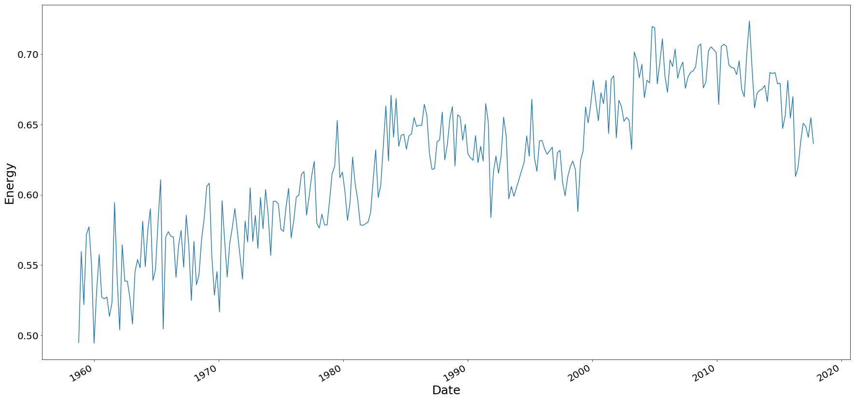
Billboard Hot 100 – Last Century
The average danceability and energy in a track on Billboard's hot 100 since 1960

Slide 6
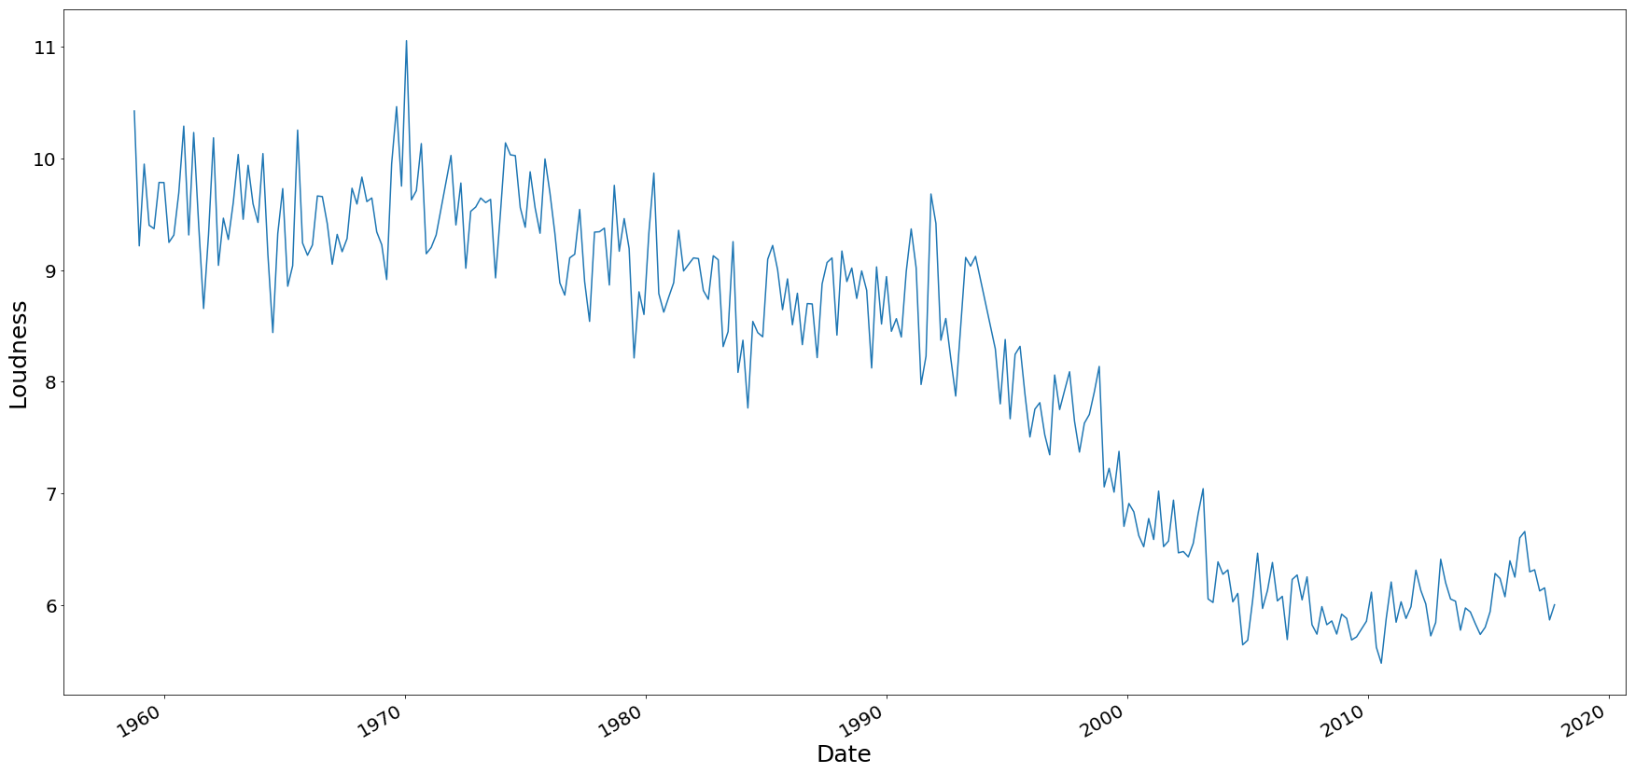
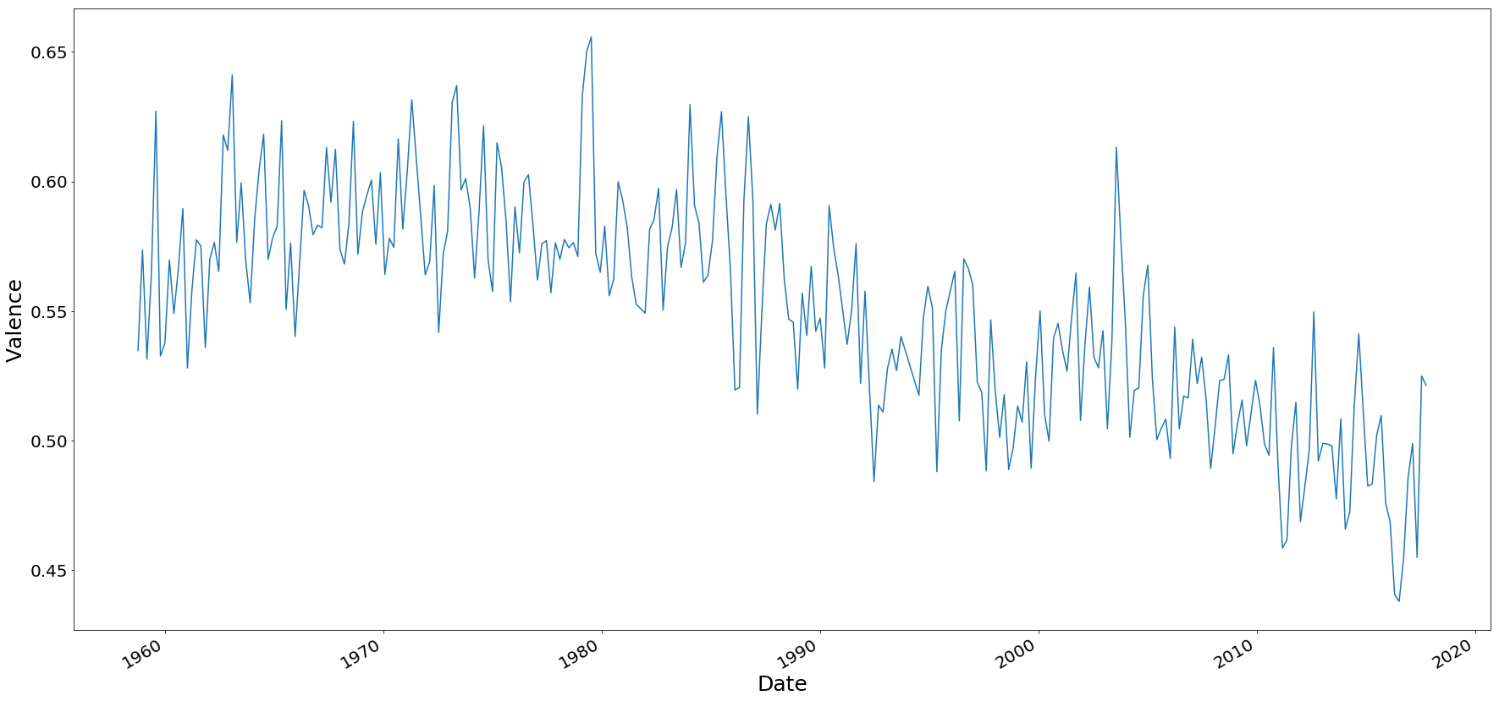
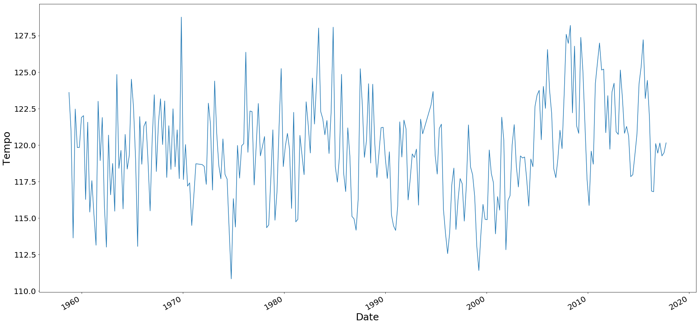
Billboard Hot 100 – Last Century
The average loudness in decibels, tempo in BPM, and valence for a track on Billboard's hot 100 since 1960

Slide 7
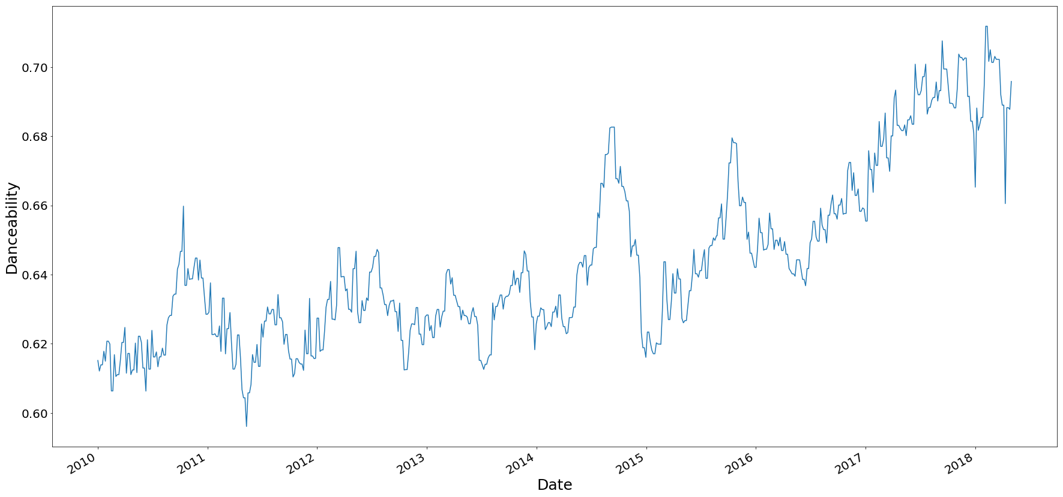
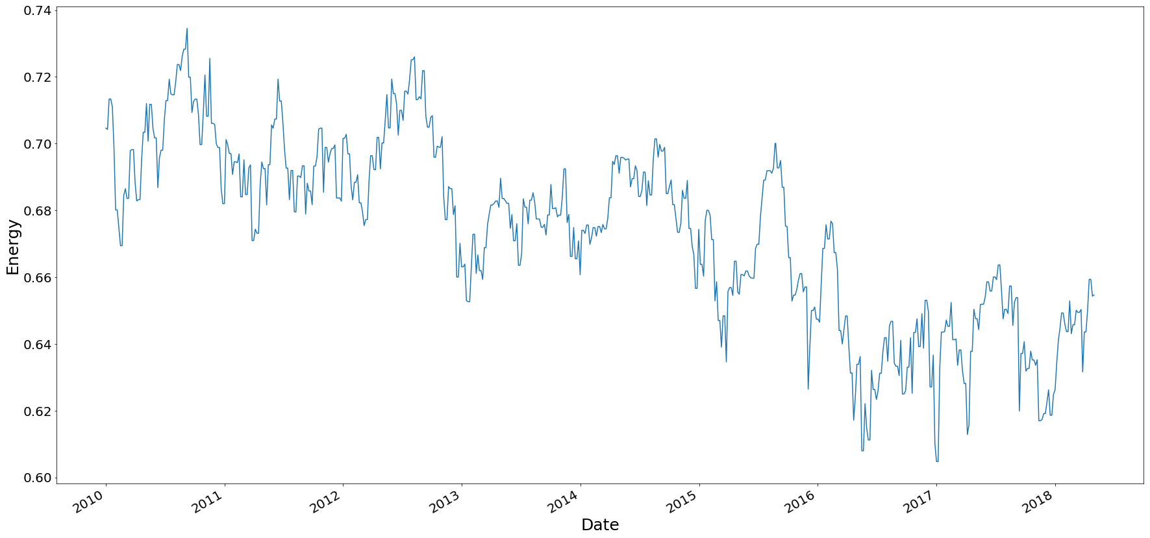
Billboard Hot 100 – Last Decade
The average danceability and energy in a track on Billboard's hot 100 since 2010

Slide 8
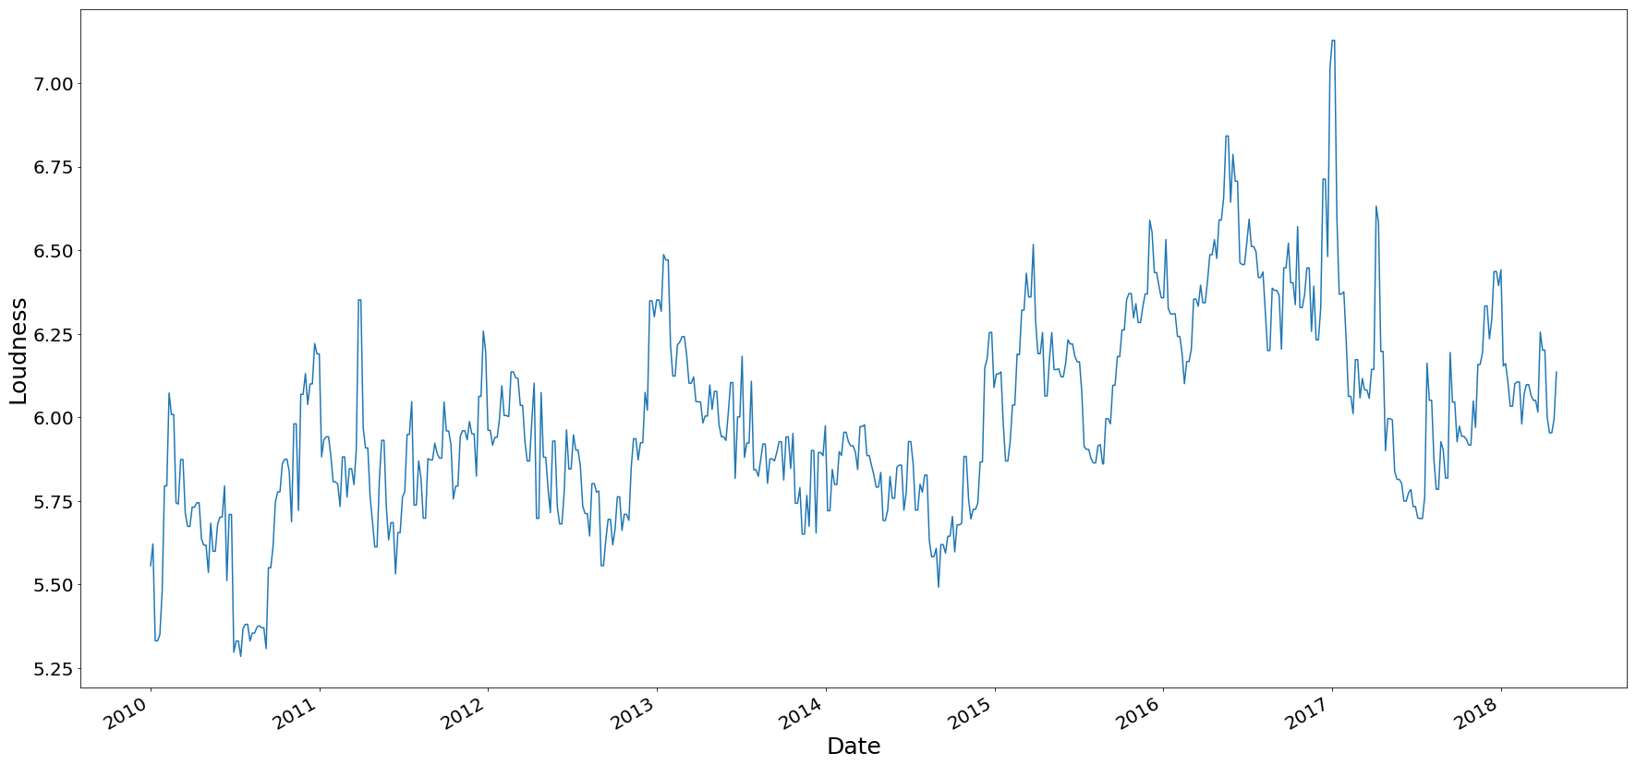
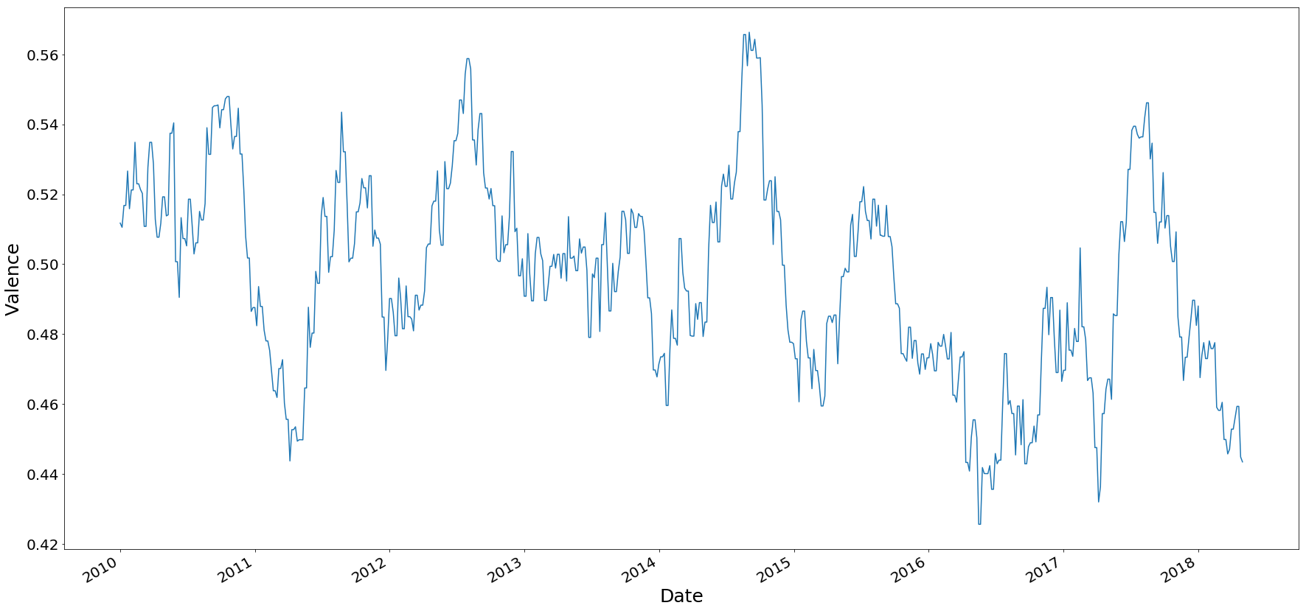
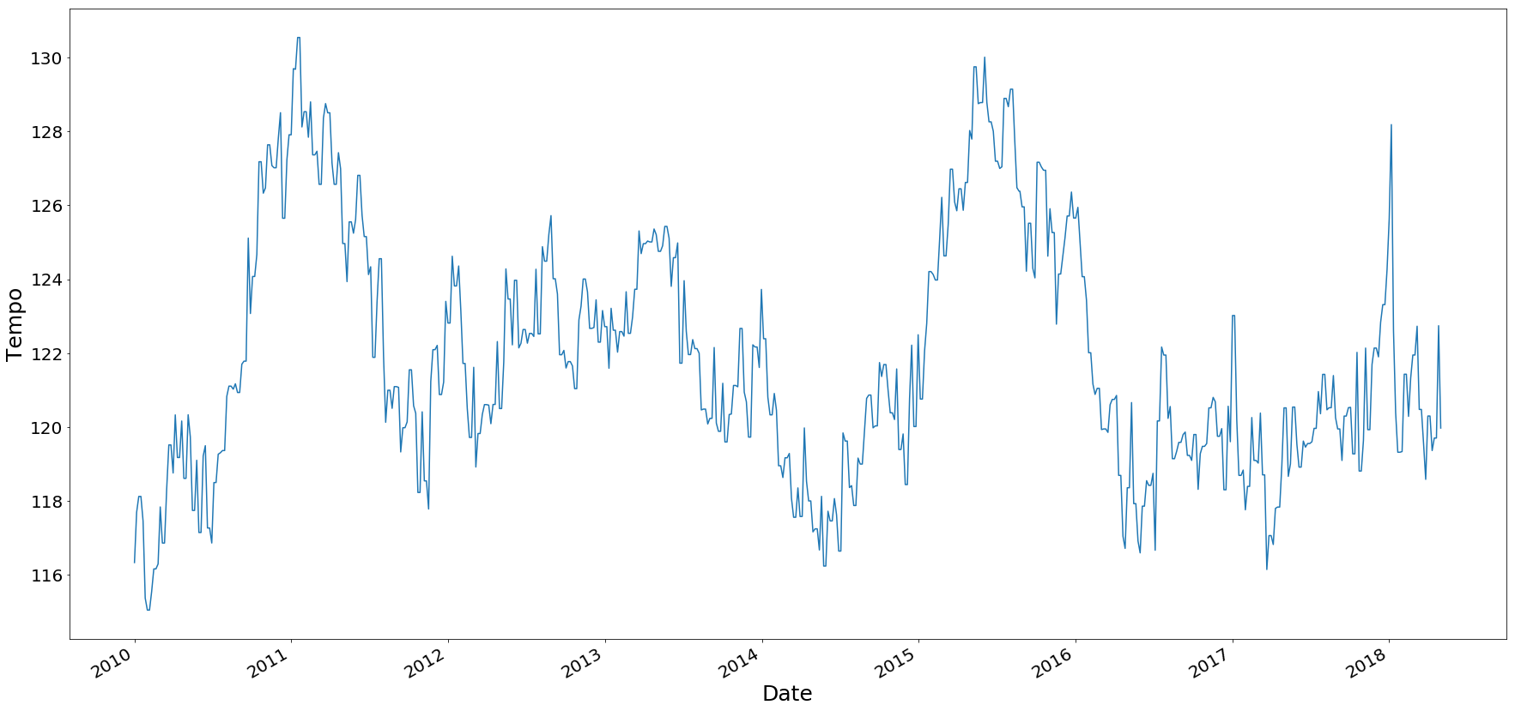
Billboard Hot 100 – Last Century
The average loudness in decibels, tempo in BPM, and valence for a track on Billboard's hot 100 since 2010

Slide 9
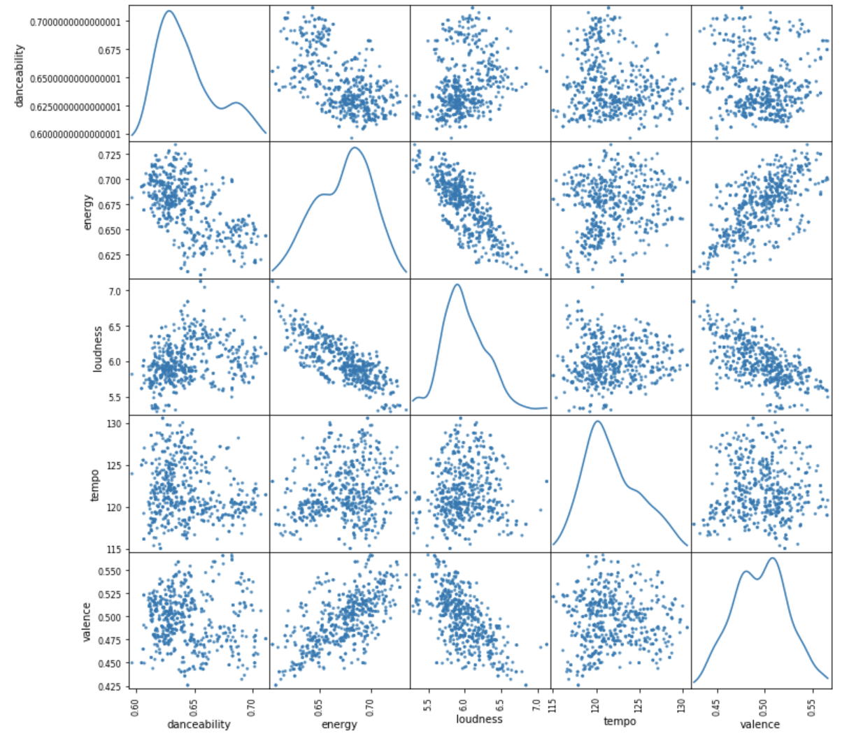
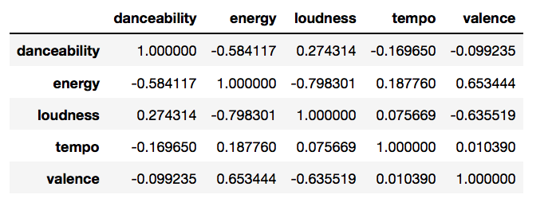
Statistical Analysis
The pearson correlation coefficient between loudness and energy is the largest by a sizeable margin.
Tempo and energy have a surprisingly low correlation coefficient.

Slide 10
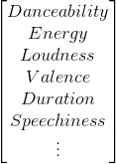
Dataset for Modeling
Finding dataset of average/unpopular songs is hard to come by.
Decided to order songs by their highest point on the chart
Arbitrarily decided to split the list where the top 30% of the songs are considered popular and the bottom 70% of the songs are considered average/unpopular
Model will act as a boolean function
Going to train on multiple combinations of features

Slide 11
ToDo's
Thinking about using Tensorflow as our modeling software
Classifying outlier and removing them
Finalizing training and test sets

Slide 12
Links
Spotify API https://beta.developer.spotify.com/documentation/web-api/
Echo Nest http://the.echonest.com/
Billboard's Hot 100 https://www.billboard.com/charts/hot-100

